Slide 1
Storytelling through Lighting
Notes:
Sdg sdf adsf awer q4j

Slide 2
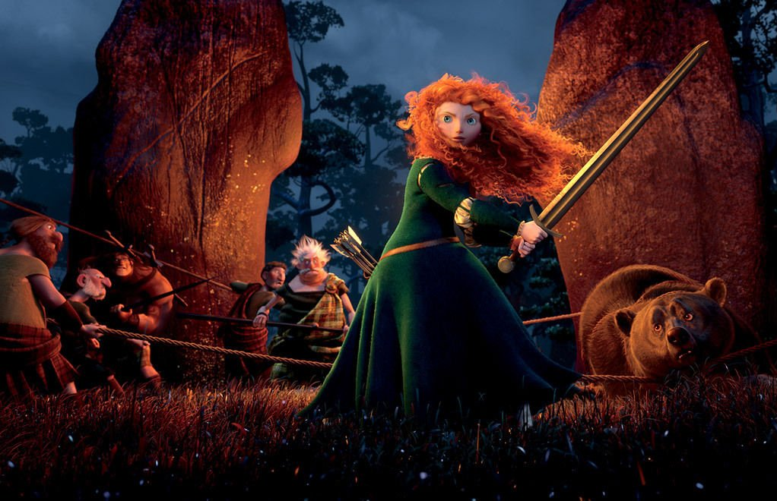
Storytelling through Light
Telling vs. Showing: Nothing in visual storytelling should be a coincidence.
The viewer needs all these pieces to put together their own interpretation of the story.
Light is one of the most important elements in visual storytelling.
Notes:
Nothing in the frame is accidental.
Every element has a purpose and should be carefully considered when telling a story.
One of the most important elements is the treatment of light.

Slide 3
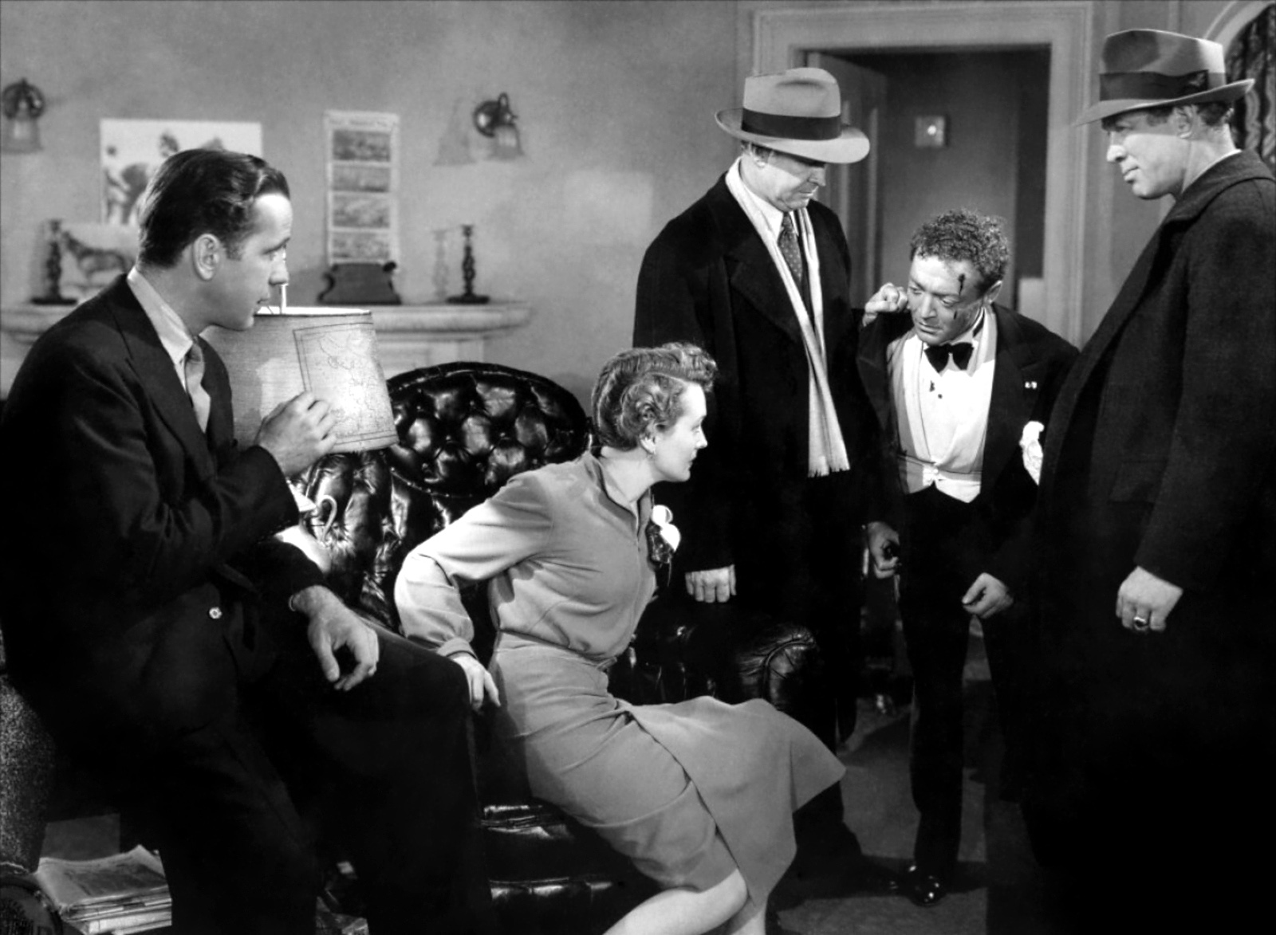
Storytelling through Light
Lighting was very important in early days of film because of its need for proper exposure.
Emergence of film noir genre helped develop lighting as a form of expression in film.
Many still use the techniques that were developed at that time today as way to direct audience’s attention.
Notes:
In the early days of film, lighting was a necessity for proper exposure, but as technology advanced so did the uses for how light could enhance story.
By the 1930s and 1940s, lighting style serve the purpose of making actors and actresses appear as glamorous as possible.
However, it wasn't until the emergence of the film noir genre that lighting style became a truly expressive form of visual storytelling.
Many films of this styled use non-traditional lighting techniques to make specific story points.
The possibilities available to enhance a visual story through specific lighting style are limitless, from the films of the 1940s to today.
Many cinematographers and lighting designers have taken the lead from film noir and have remained loyal to using light as an expressive form of defining the content and directing the viewer’s gaze within a scene.

Slide 4
Lighting Design for Film and 3D animation
While lighting for film requires light setup, lighting in 3D is done with virtual lights.
Artists mimic the skill of real-world lighting in the software.
Clear direction is needed on the intended mood for a scene.
Notes:
Project lighting design is one of the biggest artistic challenges, whether it is for film, animation, or interactive games.
The general principle for lighting and animation is the same as for live-action, but the process works a bit differently.
Whereas lighting for Live Action requires the physical setup of different lighting instruments, lighting for animation is all done on the computer.
Animations are manipulated with virtual lights, which is a feature of many software packages.
Animation and interactive games use lighting software that requires the skill of the artist to mimic the lighting conditions of the real world.
This is not an easy task since there is no standard for scripting light animation.

Slide 5
Lighting Design for Film and 3D animation
While lighting for film requires light setup, lighting in 3D is done with virtual lights.
Artists mimic the skill of real-world lighting in the software.
Clear direction is needed on the intended mood for a scene.
Notes:
When lights are manipulated in a 3D environment, an artist must use restraint and only move the lights when there is clear direction on the intended mood of for a scene.
Effective lighting design begins with visualization, which starts at the storyboard phase.
Many storyboard artist experiment with color and lied to help the director or lighting designer determine where the light and shadows should fall within a composition.
By experimenting with light early in the development process, it is likely that the director or lighting designer will be more efficient when actual production begins.
A basic lighting design is the three-point lighting setup, which is the most basic lighting formula for film and animation.

Slide 6
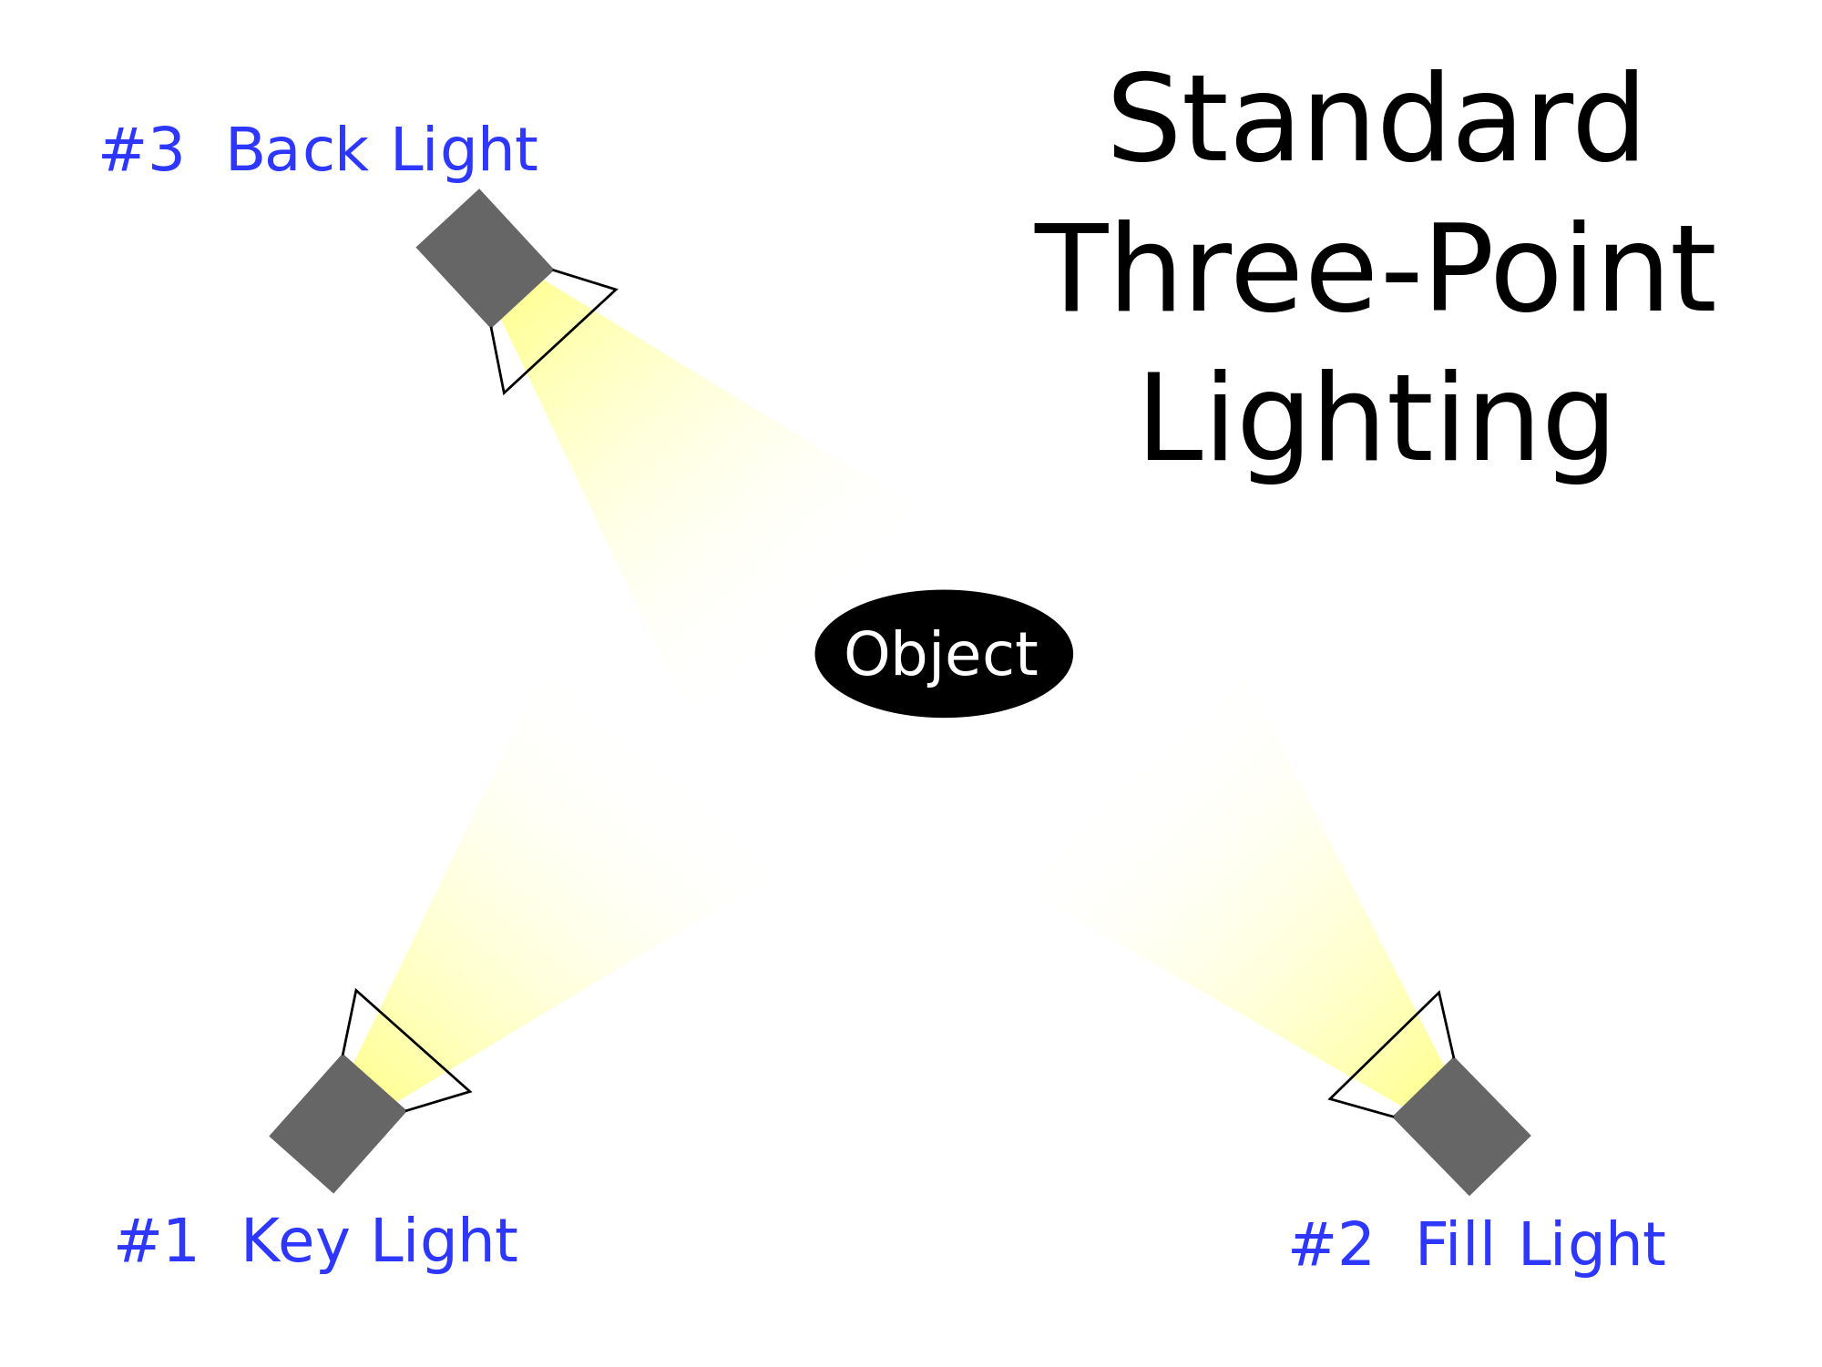
Three Point Lighting
Became a standard during the classical Hollywood of the 1930s and 1940s.
Still used as starting point for many productions.
Setup includes key light, fill light, back light.
Notes:
Three Point Lighting
Three-point lighting became a standard during the classical Hollywood of the 1930s and 1940s and continues today as the starting point for many productions.
Three-point lighting is the minimum amount of lights needed to create expressive lighting.
The setup includes the key light, fill light, and backlight.

Slide 7
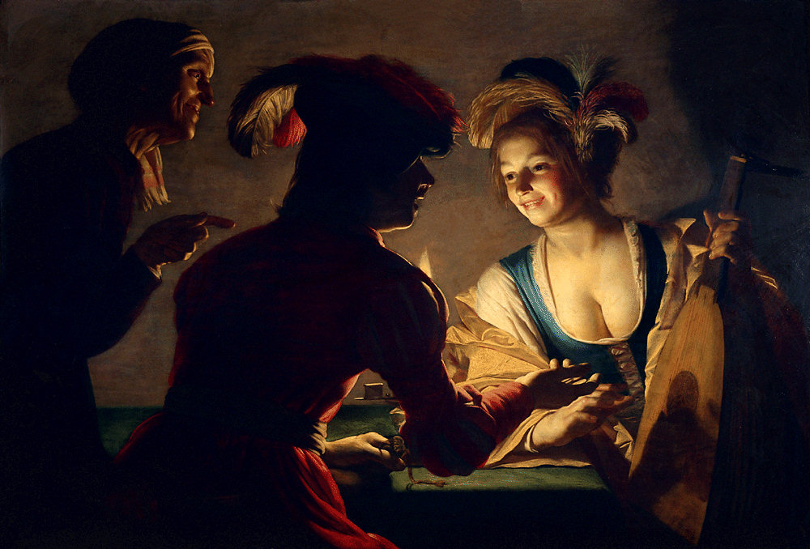
Key Light
Key light is the main source of a light that defines the main subject or object within a shot.
Usually placed at a 45 degree angle from either the right or left side of the camera.
Notes:
The key light is the main source of a light that defines the main subject or object within a shot.
The key light is usually placed at a 45 degree angle from either the right or left side of the camera.

Slide 8
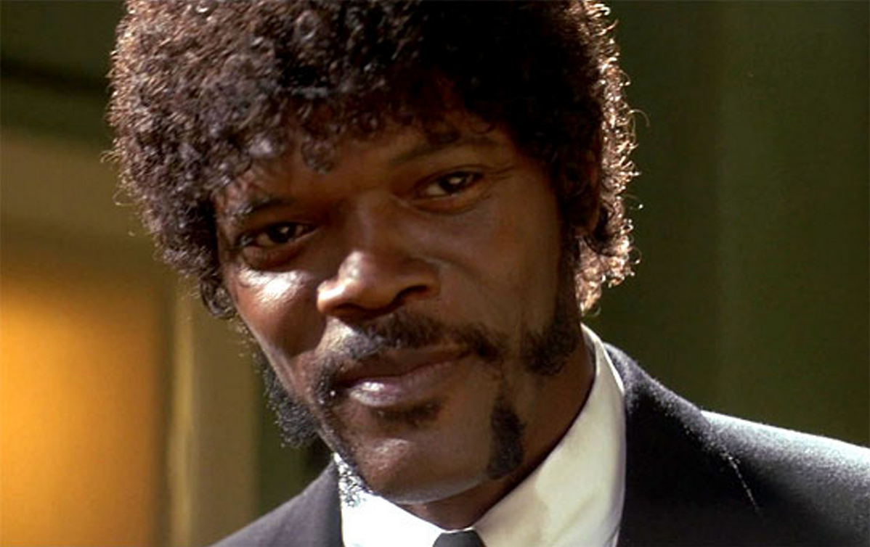
Key Light
The key light illuminates the subject and create shadows, which bring out the texture of an object or character.
The sun is often considered a key light source, although direct sunlight can produce harsh shadows at certain times of the day.
Notes:
The key light illuminates the subject and create Shadows, which bring out the texture of an object or character.
The sun is often considered a key light source, although direct sunlight can produce harsh shadows at certain times of the day.

Slide 9
Fill Light
“Fills in” or softens the shadows created from main light.
Fill light is indirect light source
Lowers contrast between light and dark by softening the shadows.
Notes:
The Fill light “fills in” or softens the Shadows created from the key light.
The Fill light is an indirect light source, which lowers the contrast between light and dark by softening the shadows.

Slide 10
Backlight
Light positioned behind an object.
Creates highlight around object, allowing it to stand out from background. Helps separate subject from background.
Can give form to things such as hair or clothing, that would otherwise fad into background.
Notes:
Backlight is a source light that is positioned behind an object or subject.
The back light creates highlight around the object, which allows the object to stand out from the background.
Back light gives form to such things as hair and clothing, which otherwise would Fade Into the background.

Slide 11
High-Key and Low-Key Lighting
Object’s appearance is usually defined by key-light, which is considered main source.
Outside examples of key-lights would be sun or moon, while inside examples would include a main light or a window.
High-key and low-key are the two types of key-lights.
Notes:
The appearance of an object is usually defined by the key light, which is often considered the main light source.
Outside, the Sun and Moon would be considered the key light.
On a bright day, the sun creates harsh shadows, whereas on an overcast day, clouds diffuse the sun, which minimizes shadows and result in a softer light.
Inside, key light sources include light streaming through a window, or overhead lights.
Two types of keylights include high-key and low-key.

Slide 12
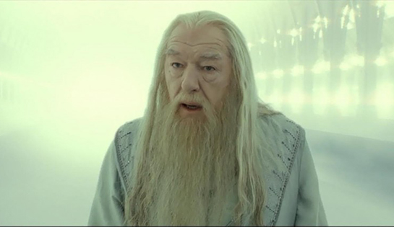
High-Key Lighting
Main source of light which conveys an overall brightness to a picture with minimal shadows.
This type of lighting is used to simulate daytime.
Seen in comedies or upbeat adventure films.
High-key lighting designs are also seen in television sitcoms, news programs, and industrial videos.
Notes:
High-key lighting is the main source of Light which conveys an overall brightness to a picture with minimal Shadows.
This type of lighting is used to simulate daytime. High key lighting is seen in comedies or upbeat adventure films.
High-key lighting designs are also seen in television sitcoms, news programs, and Industrial videos.

Slide 13
Low-Key Lighting
Low key light produces uneven distribution of light.
Abundance of shadows and concentrated areas of atmospheric light.
Many areas of low-key scene are underlit, revealing very dark areas within a frame.
The most popular low-key productions are in the film-noir style.
Other low-key productions are serious dramas, thrillers, murder mysteries, and horror films.
Notes:
Low key light produces uneven distribution of light.
With the low key lighting setup there is an abundance of shadows and concentrated areas of atmospheric light.
Many areas of low-key scene are underlit revealing very dark areas within a frame.
The most popular low-key productions are in the film-noir style.
Other low-key productions are serious dramas, thrillers, murder mysteries, and horror films.

Slide 14
Contrast
Overall contrast is the difference between the lightest and darkest parts of a frame.
By using contrast within a composition, you can focus the viewer's attention to specific areas, whereas if the entire image is sharp, the focus is on the whole.
Ansel Adam’s concept of “Zone System” in Photography.
Notes:
Contrast
Overall contrast is the difference between the lightest and darkest parts of a frame.
By using contrast within a composition, you can focus the viewer's attention to specific areas, whereas if the entire image is sharp, the focus is on the whole.

Slide 15
High-Contrast
High Contrast Lighting emphasizes differences between light and dark.
Creates dramatic and interesting images by setting off one part of an image from another.
High-Contrast is usually seen in thrillers, horror and suspense films.
Notes:
High-contrast lighting designs emphasize the extreme differences between light and dark.
This type of lighting to create dramatic and interesting images by setting off one part of an image from another.
High-contrast lighting is usually seen in Thrillers, horror and suspense films.
In the 1955 film Night of the Hunter, director Charles Laughton creates a high contrast look through stylized visuals that play light and Shadow off one another.
More recent films include Sleepy Hollow, Minority Report, and X-Men 2, among several others. Each of these films achieves a harsh high contrast look.

Slide 16
Low Contrast
No pure whites or blacks, but rather a range of grays.
Viewer takes in the overall composition rather than its parts.
Low contrast lighting is sometimes considered boring because images are usually flat.
Notes:
Low contrast
In a low contrast setting there are no pure whites or blacks, but rather a range of grays.
Within this type of setting, the viewer takes in the overall composition rather than its parts.
Low contrast lighting is sometimes considered boring because images are usually flat.

Slide 17
Light Quality
A sunny day creates harsh edges and shadows because it is a directional light.
The opposite is true of an overcast day, which creates soft diffuse shadows because the light comes from all directions.
Notes:
Lighting Quality
In order to understand the quality of light, and the differences between perceived hardness and softness of life, let's go back to the example of the Sun as a key light source.
A sunny day creates harsh edges and shadows because it is a directional light .
The opposite is true of an overcast day, which creates soft diffuse shadows because the light comes from all directions.

Slide 18
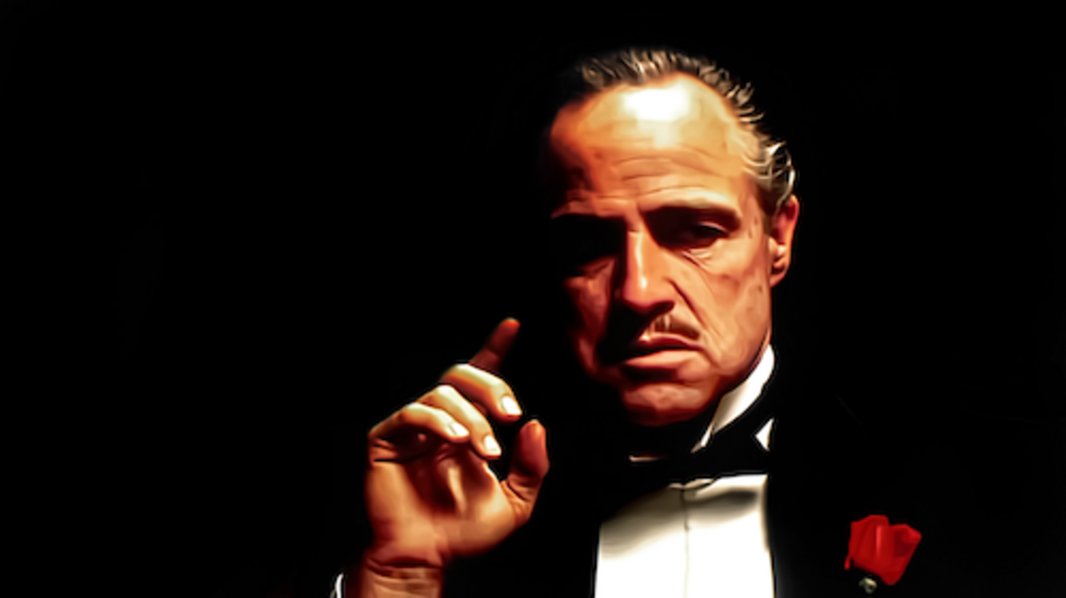
Hard Light
Hard light is often used to emphasize the dramatic
Illuminates everything; texture and imperfections.
Notes:
In film and animation, hard light is often used to emphasize the dramatic by illuminating a characters imperfections, in ways that are not always flattering.
Hard lighting casts clearly defined shadows and brings out the texture in objects.

Slide 19
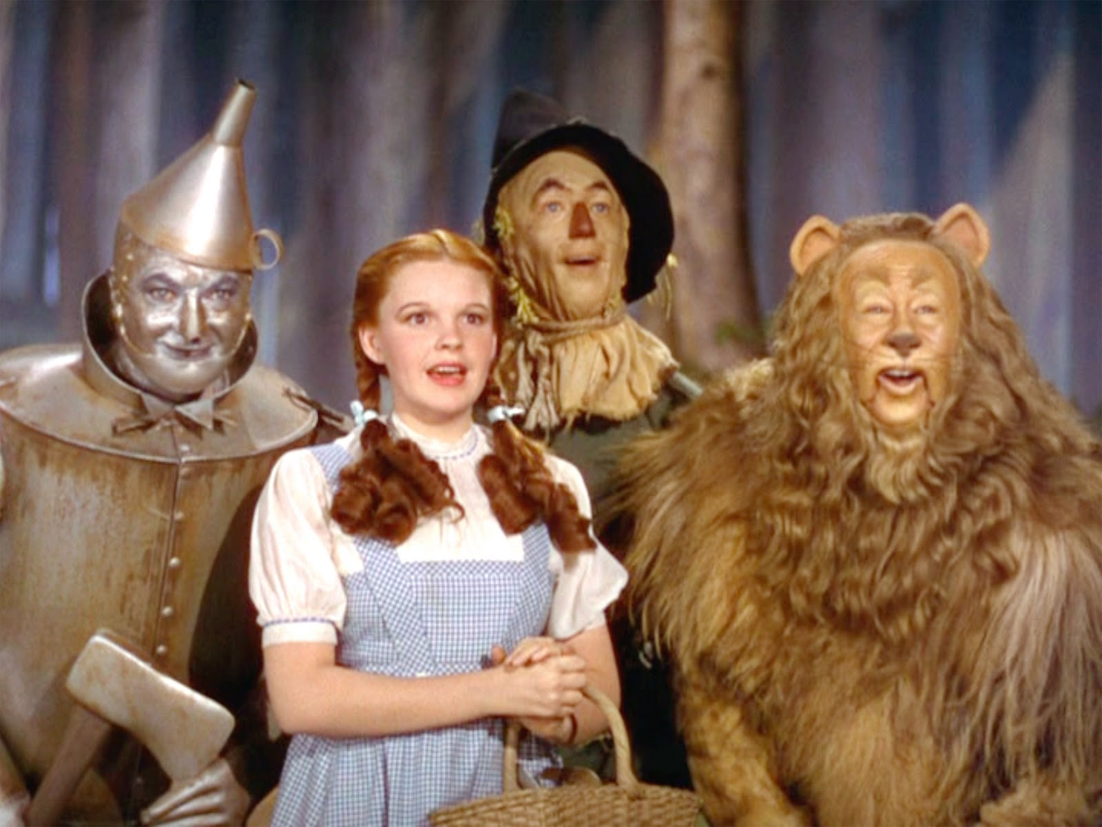
Soft Light
This sort of lighting softens the object.
Was used in the 1940’s for many actresses to even out skin tone and hide any imperfections such as wrinkles and blemishes.
Notes:
Soft light softens an object.
For example, many actresses in the 1940s were shot and soft, diffused light, which evens out skin tone and hides any imperfections, such as wrinkles and blemishes.

Slide 20
Representing Light in Storyboard Frame
The kind of shadows drawn in the storyboard frames depends on the quality of the light.
Hard light creates harsh shadows.
Notes:
When drawing storyboard frames, the kind of shadows that you create are going to depend on the quality of light.
If a scene calls for hard Light, Shadows will be harsh.
Drawing hard edges requires the use of a Sharp drawing tool.
Suppose you are going to draw a person with one light source falling harshly on one side of the face.
Look at where the highlights and shadows Fall. Start picking out prominent shadows and notice how they form patterns .
Applying Dark Shadows to these areas brings out depth within your image. Highlights are the opposite of Shadows.
They reflect the actual light source. When drawing highlights, you need to be aware of the object surface.
For example, if the surface is smooth, the likelihood of a car, highlights will be bright, but if the surface is rough, the highlights will be more diffuse.

Slide 21
Direction of Light
The direction of a light source changes the pattern of light and shadow, which affects the mood of a scene.
The direction of light is important because it cast shadows that can emphasize such things as textures and details.
Notes:
A light source may come from many different Directions, including the side, front, back, below, and above.
The direction of a light source changes the pattern of light and Shadow, which affects the mood of a scene.
The direction of light is important because it cast Shadows that can emphasize such things as textures and details.

Slide 22

Frontal Lighting
Frontal lighting creates a flat image with barely any distraction between the foreground and background elements.
With frontal lighting, there are minimal shadows and texture, which tends to create a boring composition.
Frontal lighting is good for showing the color relationships in a scene.
Notes:
Frontal Lighting
Frontal lighting creates a flat image with barely any distraction between the foreground and background elements.
With frontal lighting, there are minimal shadows and texture, which tends to create a boring composition.
Frontal lighting is good for showing the color relationships in a scene.
For example, rendering the historic building with a bed of tulips in the foreground would work well with a frontal lighting setup.

Slide 23
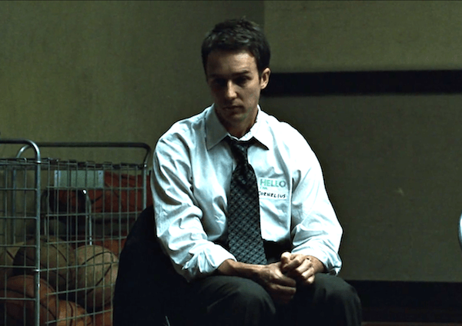
Side Lighting
A strong contrast is created when one side of an object is brightly lit and the other side is in shadows.
Side lighting creates three-dimensional effect because of the Shadows made on one side of an object.
Notes:
A strong contrast is created when one side of an object is brightly lit and the other side is in shadows.
Side lighting creates three-dimensional effect because of the shadows made on one side of an object.
Side lighting is often used to convey a protagonist struggle by being half in the light, half in the shadows.

Slide 24
Side Lighting
Side lighting is often used to convey a protagonist struggle by being half in the light, half in the shadows.
Side lighting also brings out the detail and texture of objects, such as the leaves on a tree, or the creases in a wrinkled face.
Notes:
For example, in the film Fight Club, the main protagonist, Jack , is filmed with his face partially obscured by Dark Shadows, conveying to the audience his conflict between right and wrong.
Side lighting also brings out the detail and texture of objects, such as the leaves on a tree, or the creases in a wrinkled face.

Slide 25
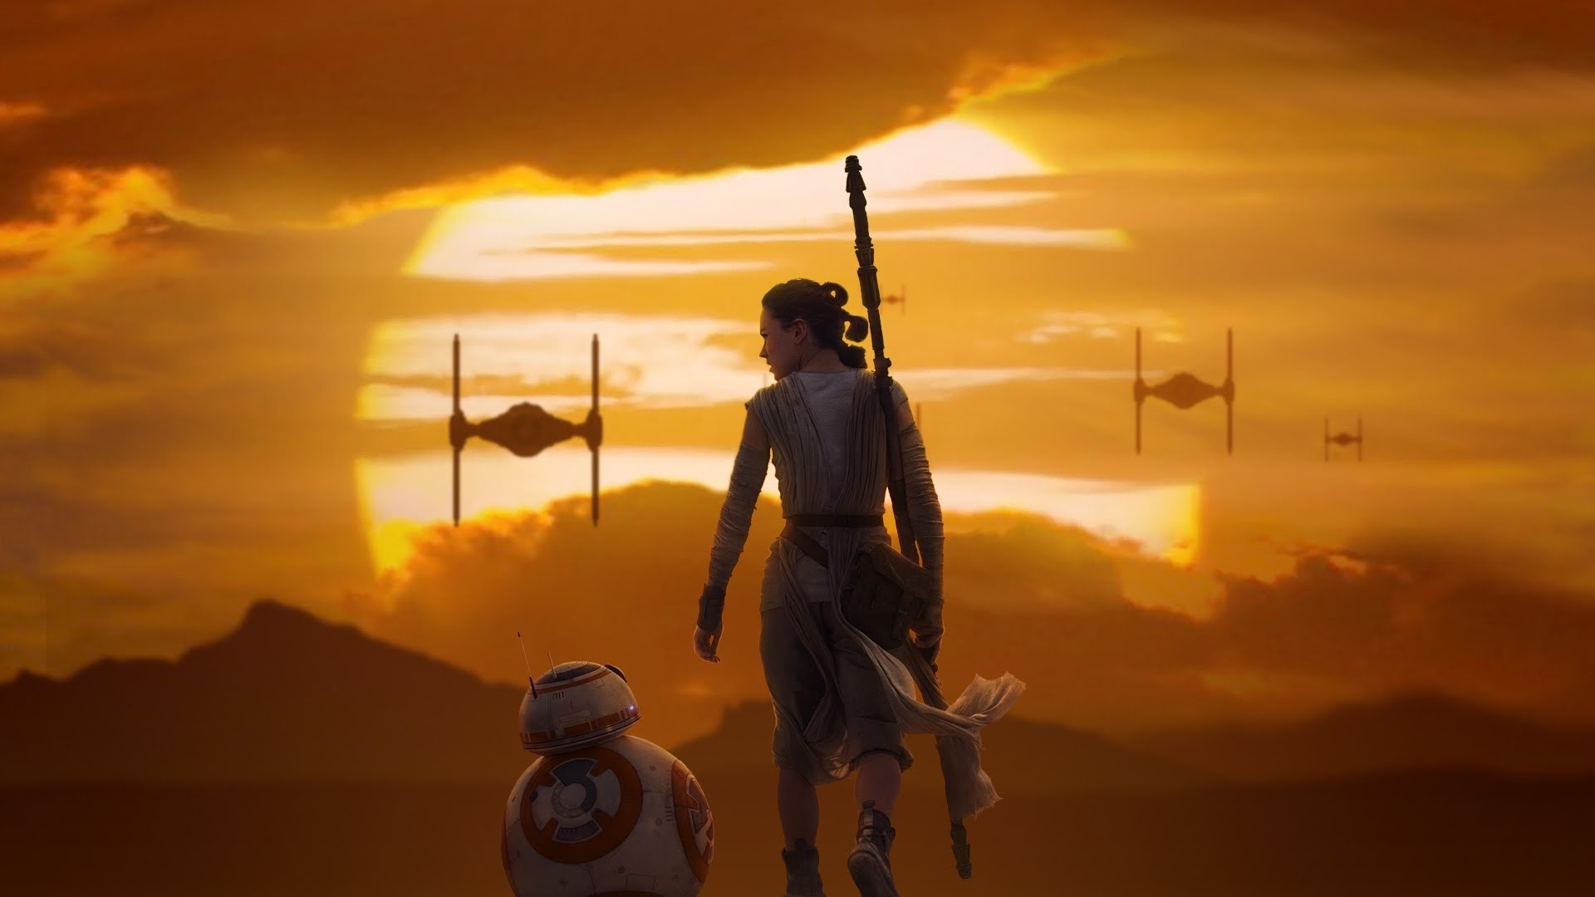
Backlighting
Backlighting is when the source of light is behind an object or character that comes forward.
Backlighting often creates the illusion of depth by separating the background from the subject.

Slide 26
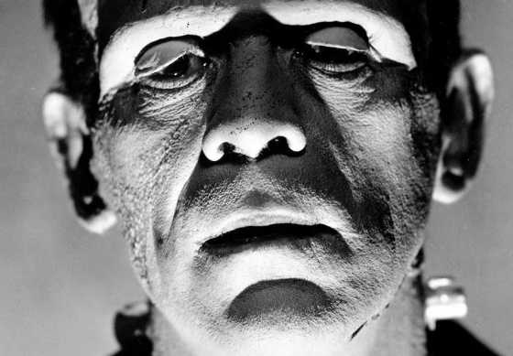
Underlighting
Comes from below an individual or object and produces odd-looking shadows.
This type of lighting illuminates the bottom half of a figure and shades the top, making a character appear malevolent and sinister.
Underlighting is seen in horror films and thrillers.

Slide 27
Understanding Lighting
Look through photography books
Observe the lighting in different environments (inside, outside)
Observe differences between light in the morning compared to afternoons and evenings.
Observing light in various situations will help you to grasp how light looks at different times of the day, and how certain lighting decisions can affect the mood.

Slide 28
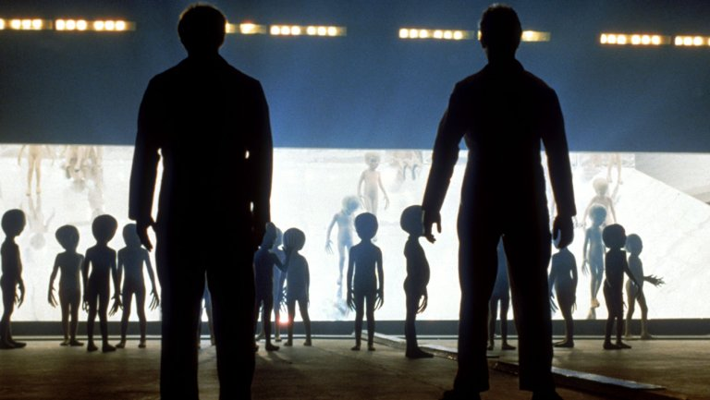
Realistic vs. Dramatic Lighting
Most productions use realistic lighting, trying to show the lighting that occurs naturally.
Light from candles, and fireplaces can enhance a realistic setting
Games often use realistic lighting to make characters look more natural.
Notes:
How much realism should be considered when envisioning a lighting design?
Most Productions strive to create scenes that look realistic.
Such pragmatic designs suggest to the audience that the lighting design occurs naturally, and it often appears in visible to the audience.
Light from candles, lamps, and fireplaces is frequently used to enhance a realistic setting.
Video games, films, and television use realistic lighting designs to make characters appear more natural.
In the film Like Water for Chocolate, many scenes are lit by candles and lied streaming through Windows to give the film a soft appearance.
Because of this realistic approach to lighting, the characters often have a warm golden appearance, making them look beautiful even when the cruelest acts are occurring.

Slide 29
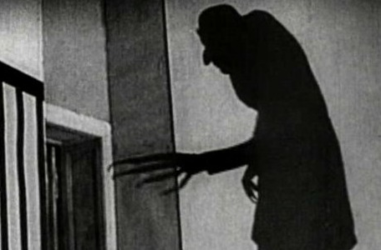
Realistic vs. Dramatic Lighting
Stylistic approach makes imagery appear more dramatic.
Stylized lighting is often used to accentuate mood.
Dramatic Lighting roots in early cinema can be found in German expressionism.
Is used in game design to emphasize to direct player’s focus.
Notes:
In contrast to naturalistic lighting a stylistic approach makes imagery appear more dramatic.
Stylized lighting is often used to accentuate mood.
The roots of dramatic Lighting in early Cinema can be found in German expressionism.
Films such as the Cabinet of dr. Caligari, metropolis, and Dracula concentrated on the heavy use of light and dark contrast to suggest the interstate of its characters, the Supernatural, and the craziness of the world.
Stylized lighting is popular with many of today's film directors and is now becoming more so among game designers.
Although many game designers use static lighting, game such as Lara Croft Tomb Raider 3 and actually Adventure game from Eidos, features dramatic lighting effects to enhance the overall quality of the game.
Many game designers use dramatic lighting to direct a player's attention to specific attributes of the game, which can be used to influence the characters choices.

Slide 30
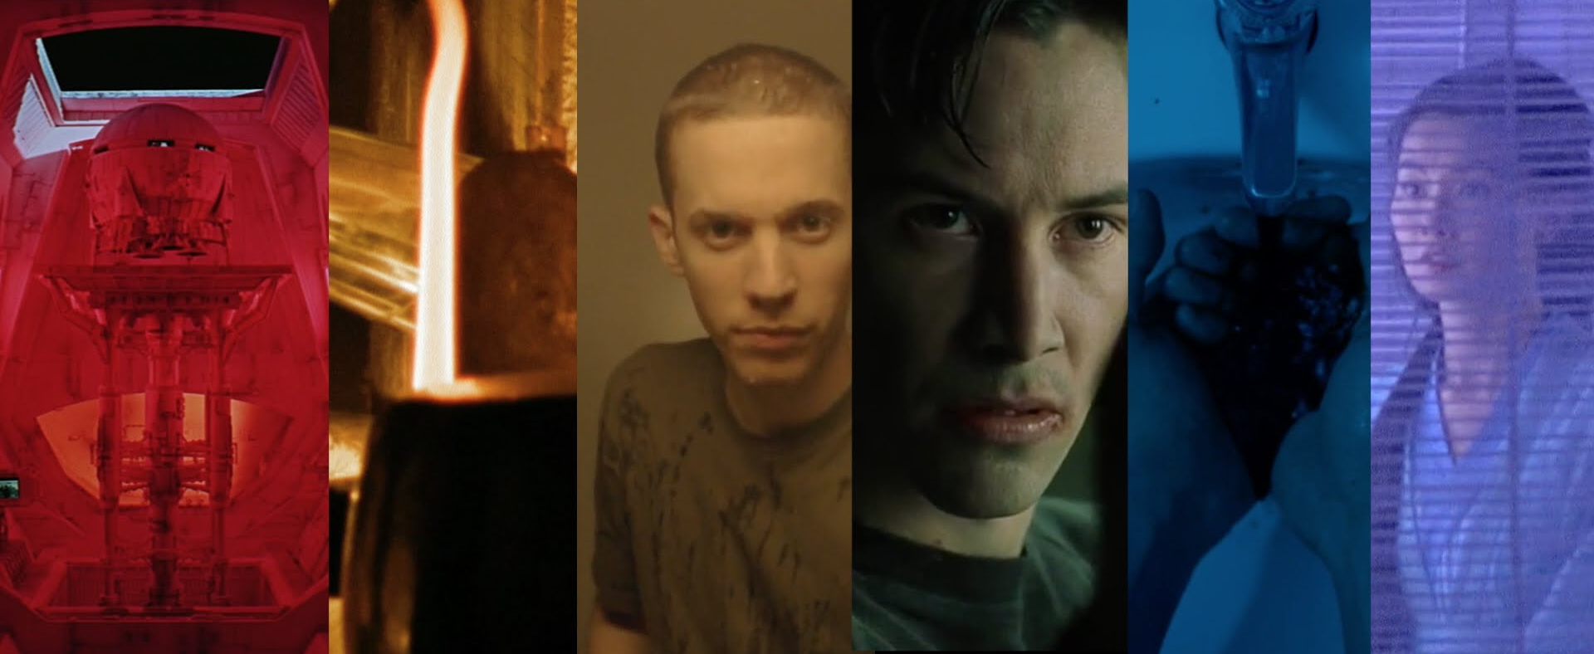
Color
Notes:
The color palette plays an important role in the visual style of a film, animation, and game design. Color often creates a sense of time and space, establishes mood and atmosphere, and provides emotional impact. Bright colors, for instance, add energy and have a dramatic impact, while lighter hues impart a more harmonious and stable look.

Slide 31
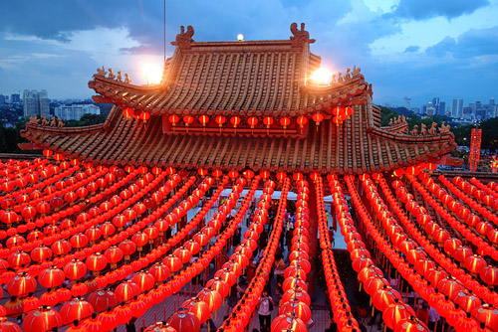
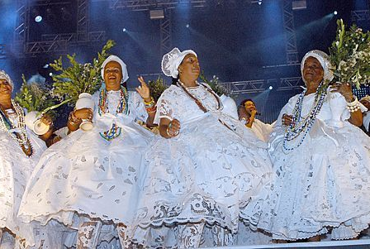
Color
Notes:
A color that causes a reaction in one person may cause a very different reaction in someone else.
Sometimes this is due to personal preference, and other times due to cultural background.
Color theory is a science in itself.
Studying how colors affect different people, either individually or as a group, is something some people build their careers on. And there’s a lot to it.
Something as simple as changing the exact hue or saturation of a color can evoke a completely different feeling. Cultural differences mean that something that’s happy and uplifting in one country can be depressing in another.

Slide 32
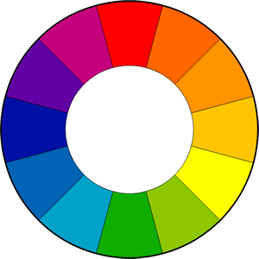
Color Wheel and The Basics of Color
Most common color wheel is based on the 12 color model.
All colors in the RYB model are made up of either Red, Yellow or Blue.
These colors are called primary colors.
Notes:
The color wheel or color circle is the basic tool for combining colors.
Over the years, many variations of the basic design have been made, but the most common version is a wheel of 12 colors based on the RYB (or artistic) color model.
All colors are made up of three primary colors: Red, Yellow and Blue. New colors such as green and purple and orange are created by mixing colors together.
These are called secondary colors.

Slide 33
Color Wheel and The Basics of Color
Examples of secondary colors would include orange, green, and magenta, these are colors between primary colors on the color wheel.
Colors between the secondary colors are called tertiary.
Color harmonies, or color chords are combinations considered pleasing.
Notes:
Examples of secondary colors would include orange, green, and magenta.
As you can see on the color wheel above, these are colors between primary colors on the color wheel.
Colors between the secondary colors are called tertiary.
Traditionally, there are a number of color combinations that are considered especially pleasing. These are called color harmonies or color chords and they consist of two or more colors with a fixed relation in the color wheel.

Slide 34
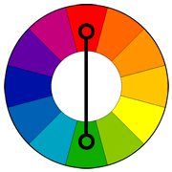
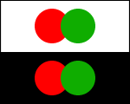
Complimentary Colors
Colors that are opposite each other on the color wheel are considered to be complementary colors.
Notes:
Colors that are opposite each other on the color wheel are considered to be complementary colors (example: red and green).
The high contrast of complementary colors creates a vibrant look especially when used at full saturation. This color scheme must be managed well so it is not jarring.
Complementary color schemes are tricky to use in large doses, but work well when you want something to stand out.
Complementary colors are really bad for text.

Slide 35
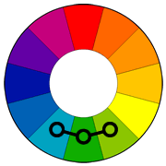
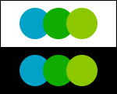
analagous colors
Analogous color schemes use colors that are next to each other on the color wheel.
These are colors that tend to be found together in nature.
Notes:
Analogous color schemes use colors that are next to each other on the color wheel.
They usually match well and create serene and comfortable designs.
Analogous color schemes are often found in nature and are harmonious and pleasing to the eye.

Slide 36
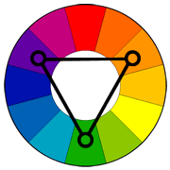
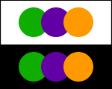
triadic colors
Triadic color scheme uses colors that are evenly spaced around the color wheel.
Tend to be vibrant.
Notes:
A triadic color scheme uses colors that are evenly spaced around the color wheel.
Triadic color schemes tend to be quite vibrant, even if you use pale or unsaturated versions of your hues.

Slide 37
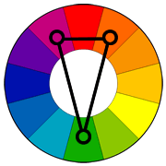
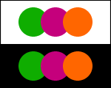
split complimentary colors
variation of the complementary color scheme.
uses the two colors adjacent to its complementary color.
Same strong visual contrast as the complementary color scheme, but has less tension.
Notes:
The split-complementary color scheme is a variation of the complementary color scheme.
In addition to the base color, it uses the two colors adjacent to its complement.
This color scheme has the same strong visual contrast as the complementary color scheme, but has less tension.

Slide 38
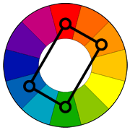
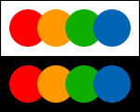
rectangle (tetradic) color scheme
Uses four colors arranged into two complementary pairs.
Rich color scheme offers plenty of possibilities for variation.
Notes:
Rectangle (tetradic) color scheme The rectangle or tetradic color scheme uses four colors arranged into two complementary pairs.
This rich color scheme offers plenty of possibilities for variation.

Slide 39
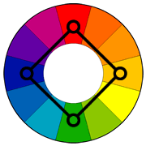
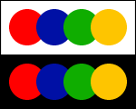
square color scheme
4 colors evenly distributed
warm vs. cool
Notes:
The square color scheme is similar to the rectangle, but with all four colors spaced evenly around the color circle.
Square color schemes works best if you let one color be dominant.
You should also pay attention to the balance between warm and cool colors in your design.

Slide 40
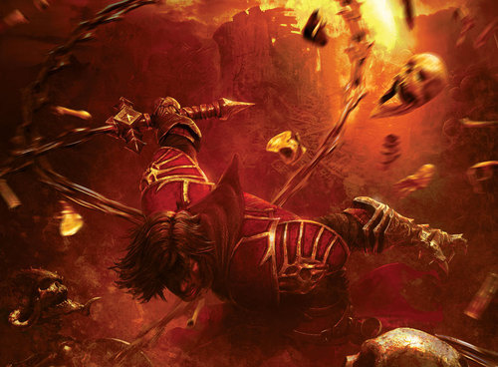
Warm Colors
red, orange, yellow
strong, energetic, passion
Notes:
Warm colors include red, orange, and yellow, and variations of those three colors.
These are the colors of fire, of fall leaves, and of sunsets and sunrises, and are generally energizing, passionate, and positive.
As you’ve probably seen, colors can be used to influence mood.
Red and yellow are both primary colors, with orange falling in the middle, which means warm colors are all truly warm and aren’t created by combining a warm color with a cool color. Use warm colors in your designs to reflect passion, happiness, enthusiasm, and energy.

Slide 41
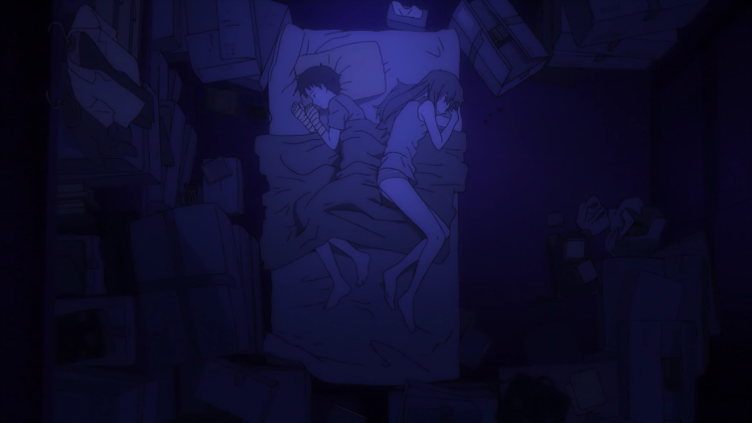
cool colors
blue, green, purple calm, relaxing, sad, etc.
Notes:
Cool colors include green, blue, and purple, are often more subdued than warm colors. They are the colors of night, of water, of nature, and are usually calming, relaxing, and somewhat reserved.
Blue is the only primary color within the cool spectrum, which means the other colors are created by combining blue with a warm color (yellow for green and red for purple). Greens take on some of the attributes of yellow, and purple takes on some of the attributes of red. Use cool colors in your designs to give a sense of calm or professionalism.

Slide 42
Meanings of Color
Black - Authority, power, evil, pessimism. Red - Optimism, sex, danger, aggression, energy, excitement, passion, fire, love Green - Envy, fertility, growth, money, luck, healing, success Pink - tranquility, love, flirtatiousness, softness, delicacy, sweetness Yellow - cheerfulness, joy, optimism, happiness, energy Orange - joy, creativity, energy, success, encouragement Purple - royalty, power, nobility, luxury, spirituality, wisdom, mystery, wealth Blue - calmness, truth, peace, harmony, confidence, wisdom, loyalty, healing, water, stability White - innocence, sterility, purity Gray - neutrality, corporate, quality, practicality Brown - stability, endurance, simplicity, friendship
Notes:
Cool colors include green, blue, and purple, are often more subdued than warm colors. They are the colors of night, of water, of nature, and are usually calming, relaxing, and somewhat reserved.
Blue is the only primary color within the cool spectrum, which means the other colors are created by combining blue with a warm color (yellow for green and red for purple). Greens take on some of the attributes of yellow, and purple takes on some of the attributes of red. Use cool colors in your designs to give a sense of calm or professionalism.

